Slide 1
Section 6.1
Composite Functions
Copyright © 2012 Pearson Education, Inc. Publishing as Prentice Hall.

Slide 2

Copyright © 2012 Pearson Education, Inc. Publishing as Prentice Hall.

Slide 3
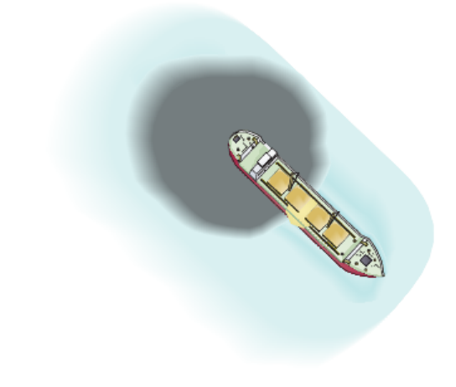


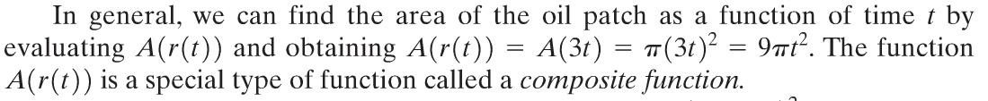
Suppose that an oil tanker is leaking oil and we want to be able to determine the area o the circular oil patch around the ship. It is determined that the oil is leaking from the tanker in such a way that the radius of the circular oil patch around the ship is increasing at a rate of 3 feet per minute.
Copyright © 2012 Pearson Education, Inc. Publishing as Prentice Hall.

Slide 4

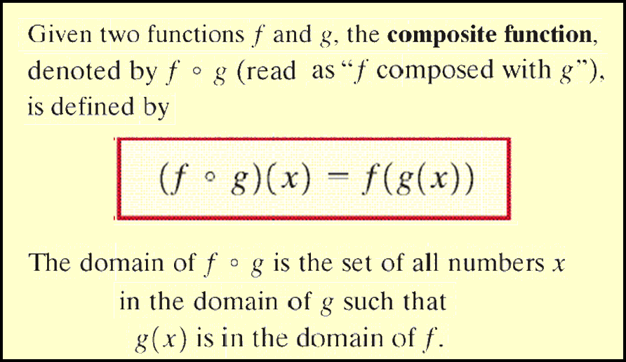
Copyright © 2012 Pearson Education, Inc. Publishing as Prentice Hall.

Slide 5
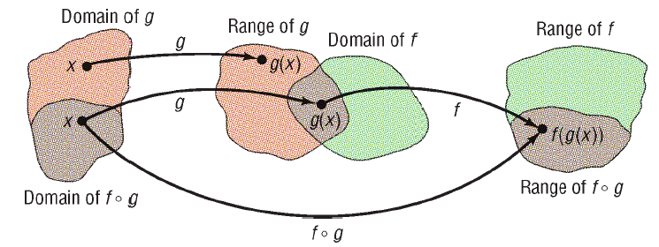
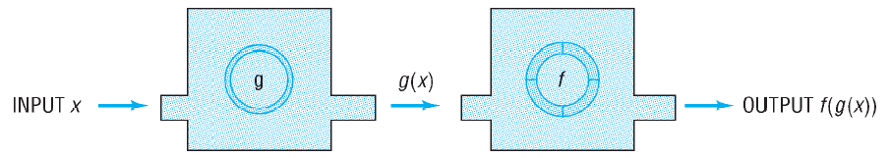
Copyright © 2012 Pearson Education, Inc. Publishing as Prentice Hall.

Slide 6

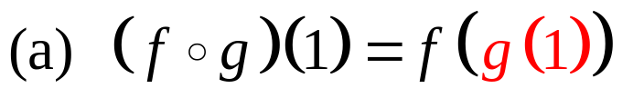
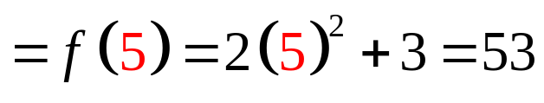
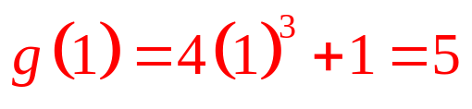
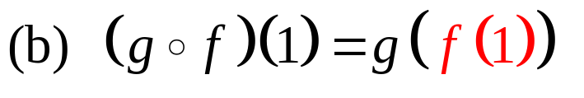
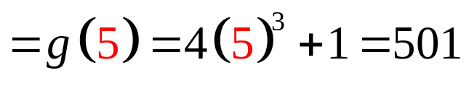
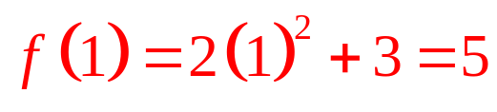
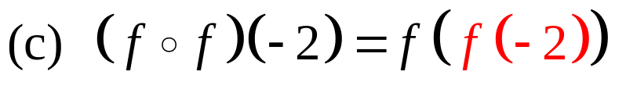
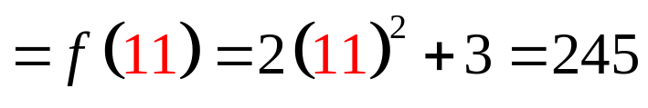
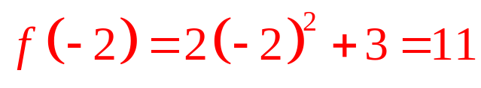
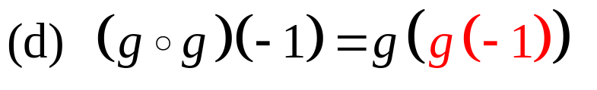
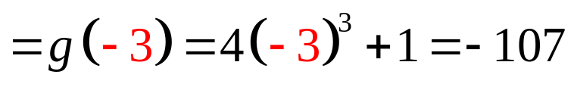
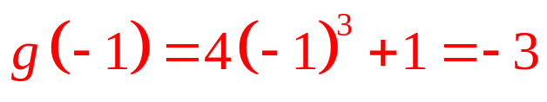
Copyright © 2012 Pearson Education, Inc. Publishing as Prentice Hall.

Slide 7


Copyright © 2012 Pearson Education, Inc. Publishing as Prentice Hall.

Slide 8
Copyright © 2012 Pearson Education, Inc. Publishing as Prentice Hall.

Slide 9

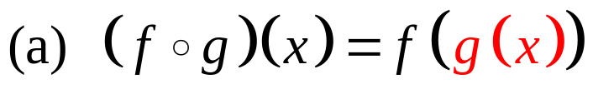
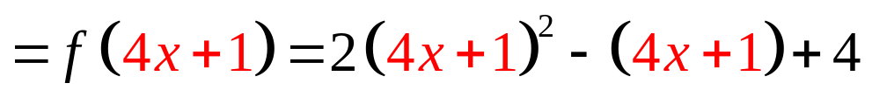
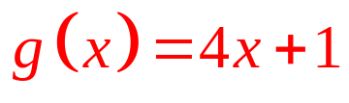
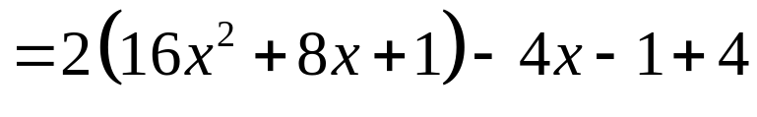


The domain of g is all real numbers as is the domain of the composite function, so the domain of f ◦ g is the set of all real numbers.
Copyright © 2012 Pearson Education, Inc. Publishing as Prentice Hall.

Slide 10
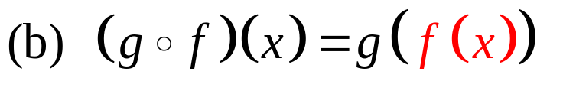
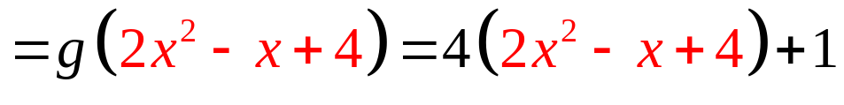
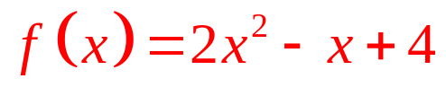


The domain of f is all real numbers as is the domain of the composite function, so the domain of g ◦ f is the set of all real numbers.
Copyright © 2012 Pearson Education, Inc. Publishing as Prentice Hall.

Slide 11
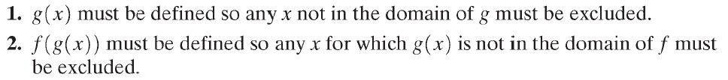
Copyright © 2012 Pearson Education, Inc. Publishing as Prentice Hall.

Slide 12
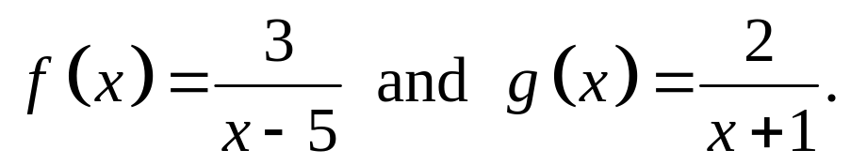
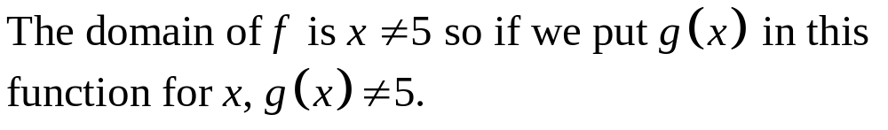
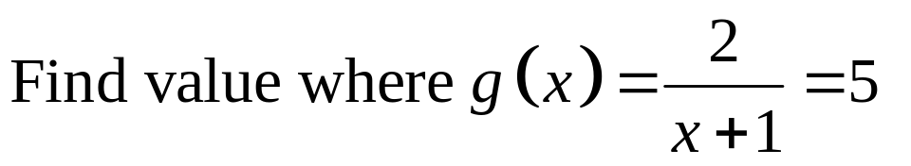
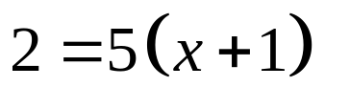

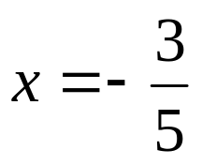
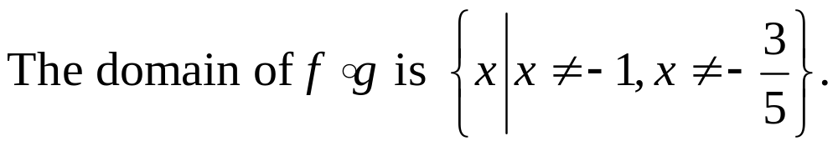
Copyright © 2012 Pearson Education, Inc. Publishing as Prentice Hall.

Slide 13
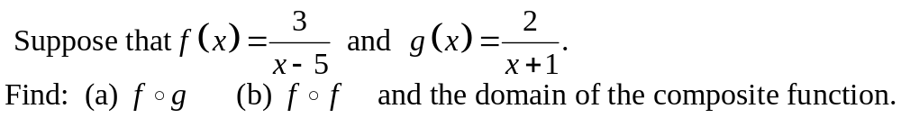
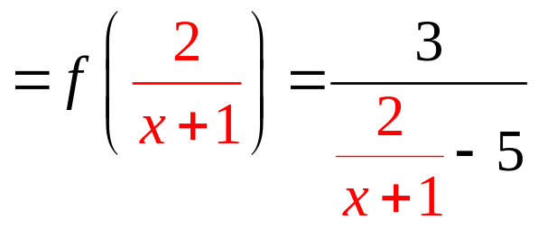
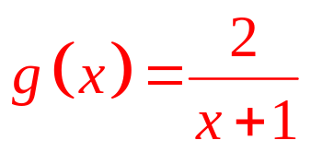
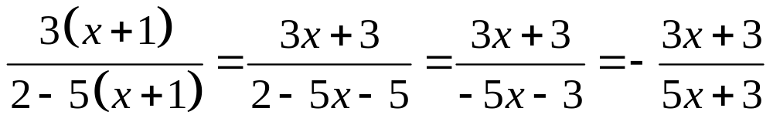
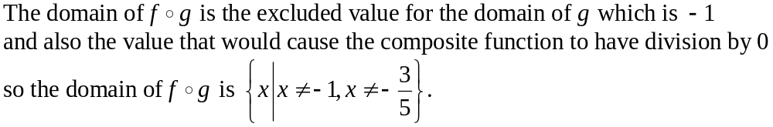
Copyright © 2012 Pearson Education, Inc. Publishing as Prentice Hall.

Slide 14
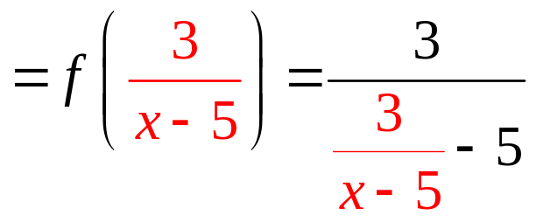
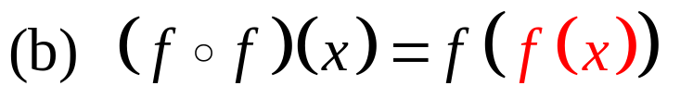
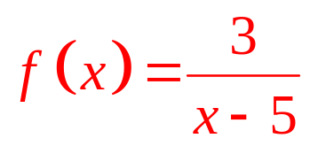
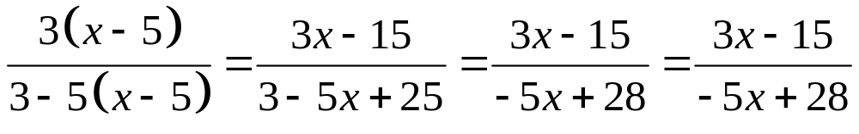
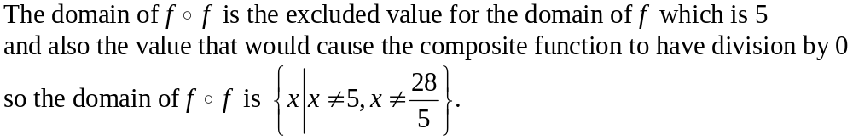
Copyright © 2012 Pearson Education, Inc. Publishing as Prentice Hall.

Slide 15
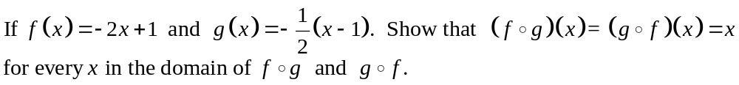
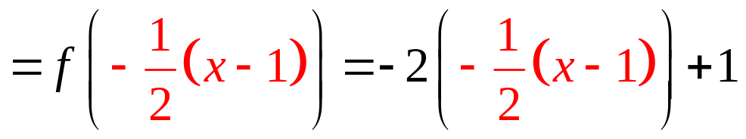
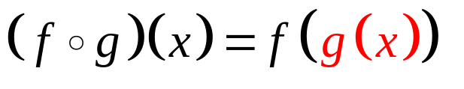
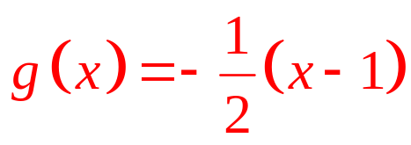
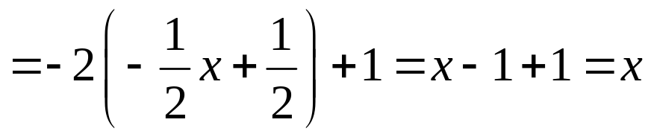
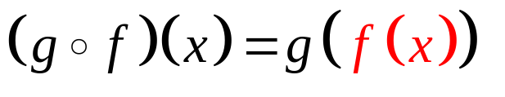
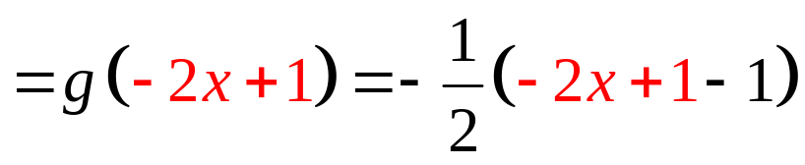
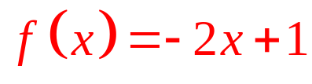
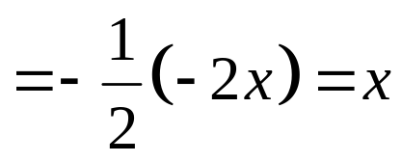
Copyright © 2012 Pearson Education, Inc. Publishing as Prentice Hall.

Slide 16

Copyright © 2012 Pearson Education, Inc. Publishing as Prentice Hall.

Slide 17




Copyright © 2012 Pearson Education, Inc. Publishing as Prentice Hall.

Slide 18





Copyright © 2012 Pearson Education, Inc. Publishing as Prentice Hall.

